Slide 1
How to Add Furniture in a House Sketch Up
By: Ethan Hsu & Diya Patel

Slide 2
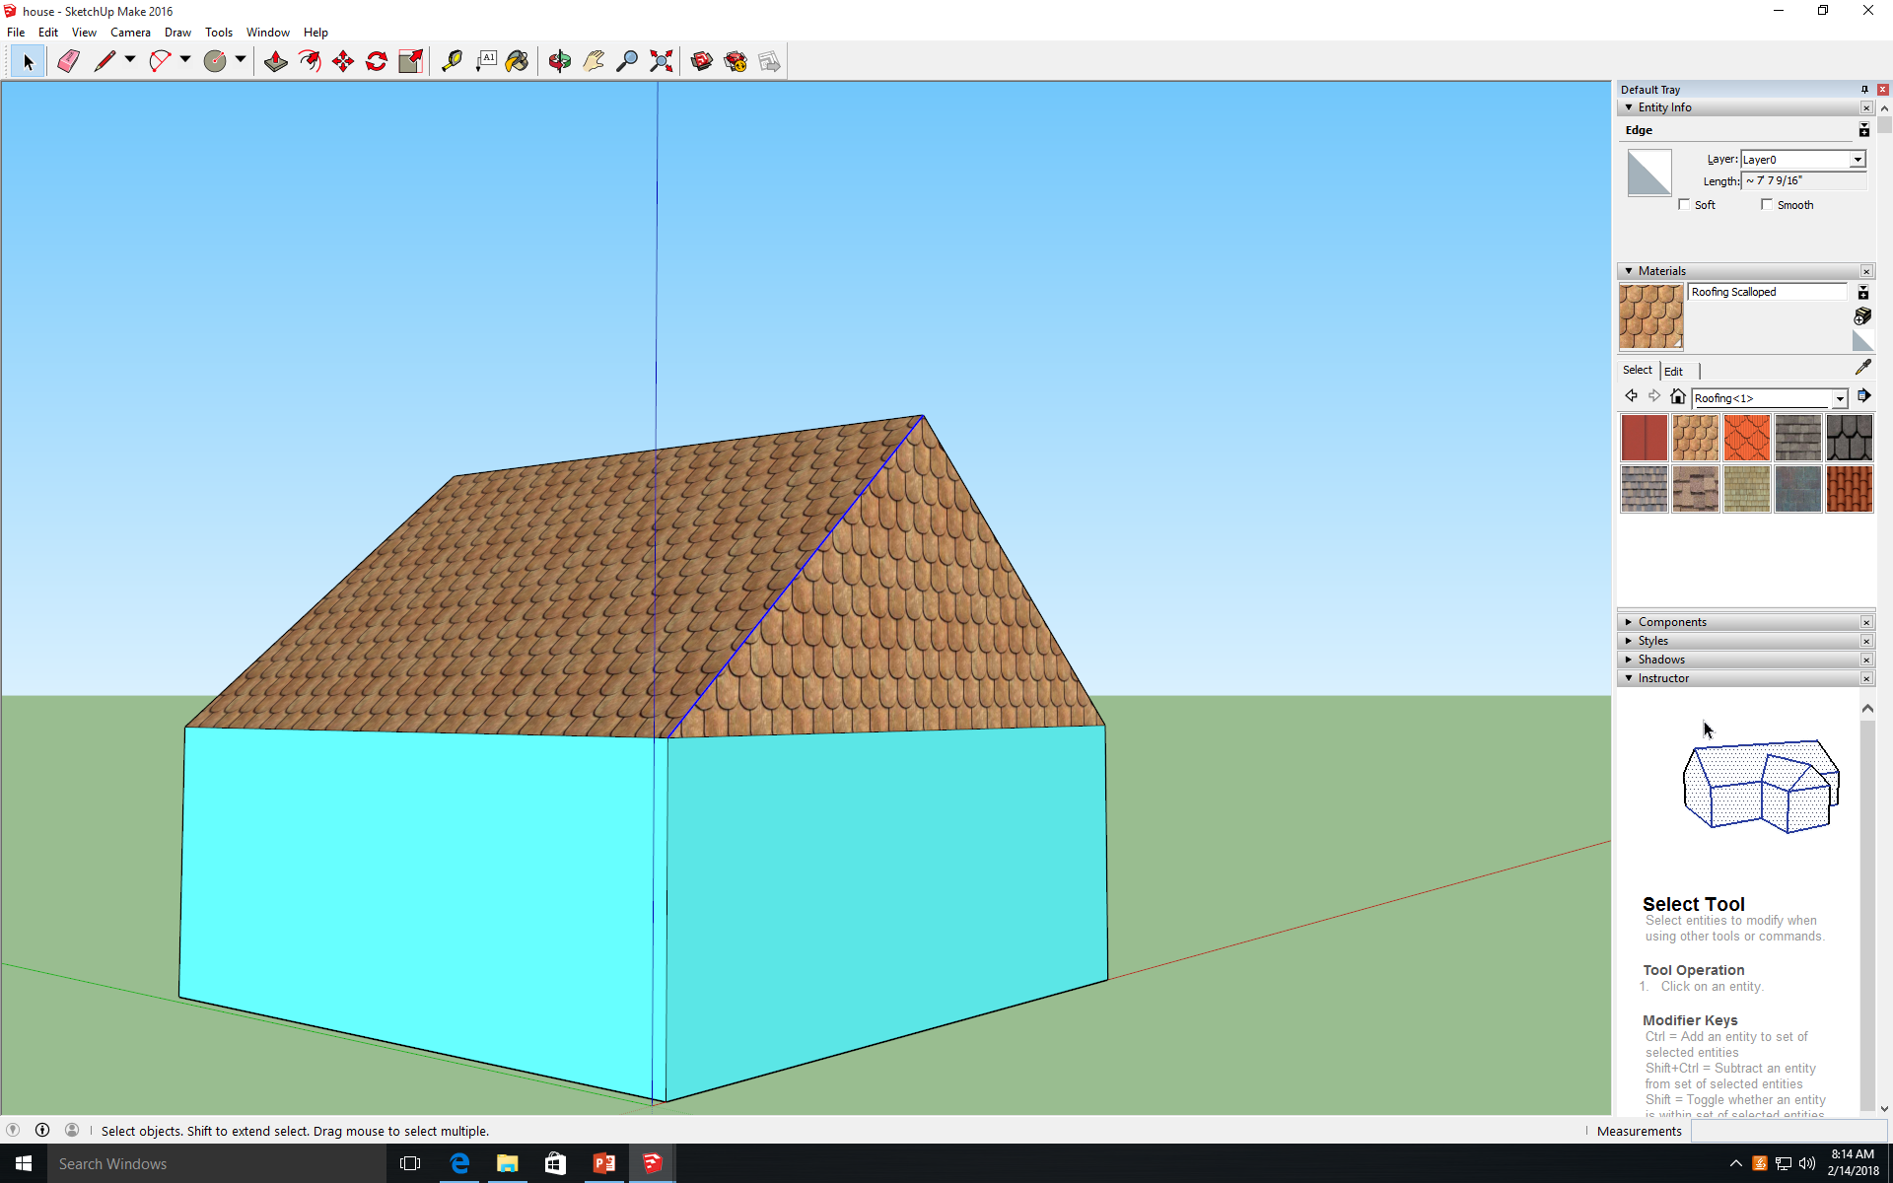
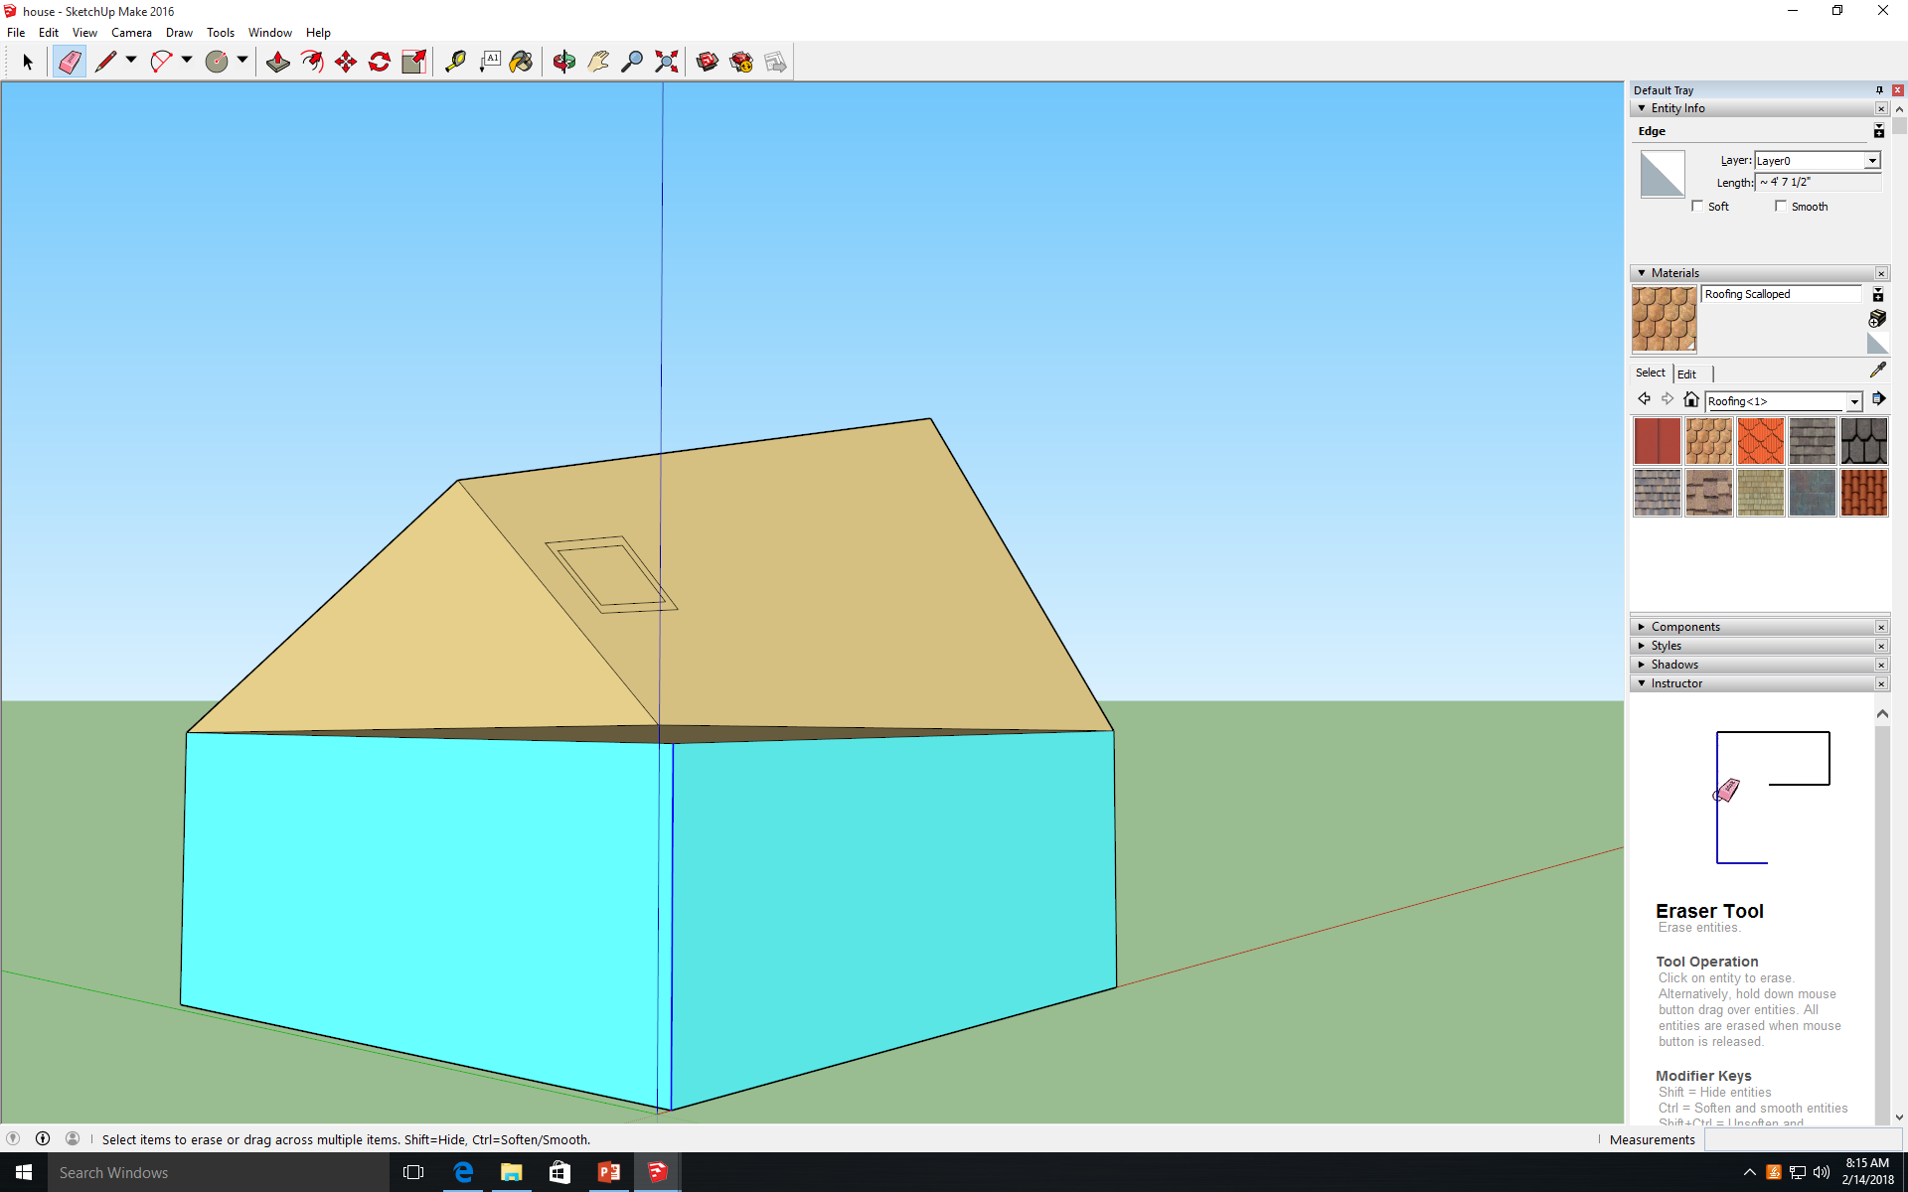
How to Add Furniture in a House Sketch Up
1. Use the pointer tool to select a line that connect two sides together.
2. Use the eraser tool to erase the line that connects two sides together.

Slide 3
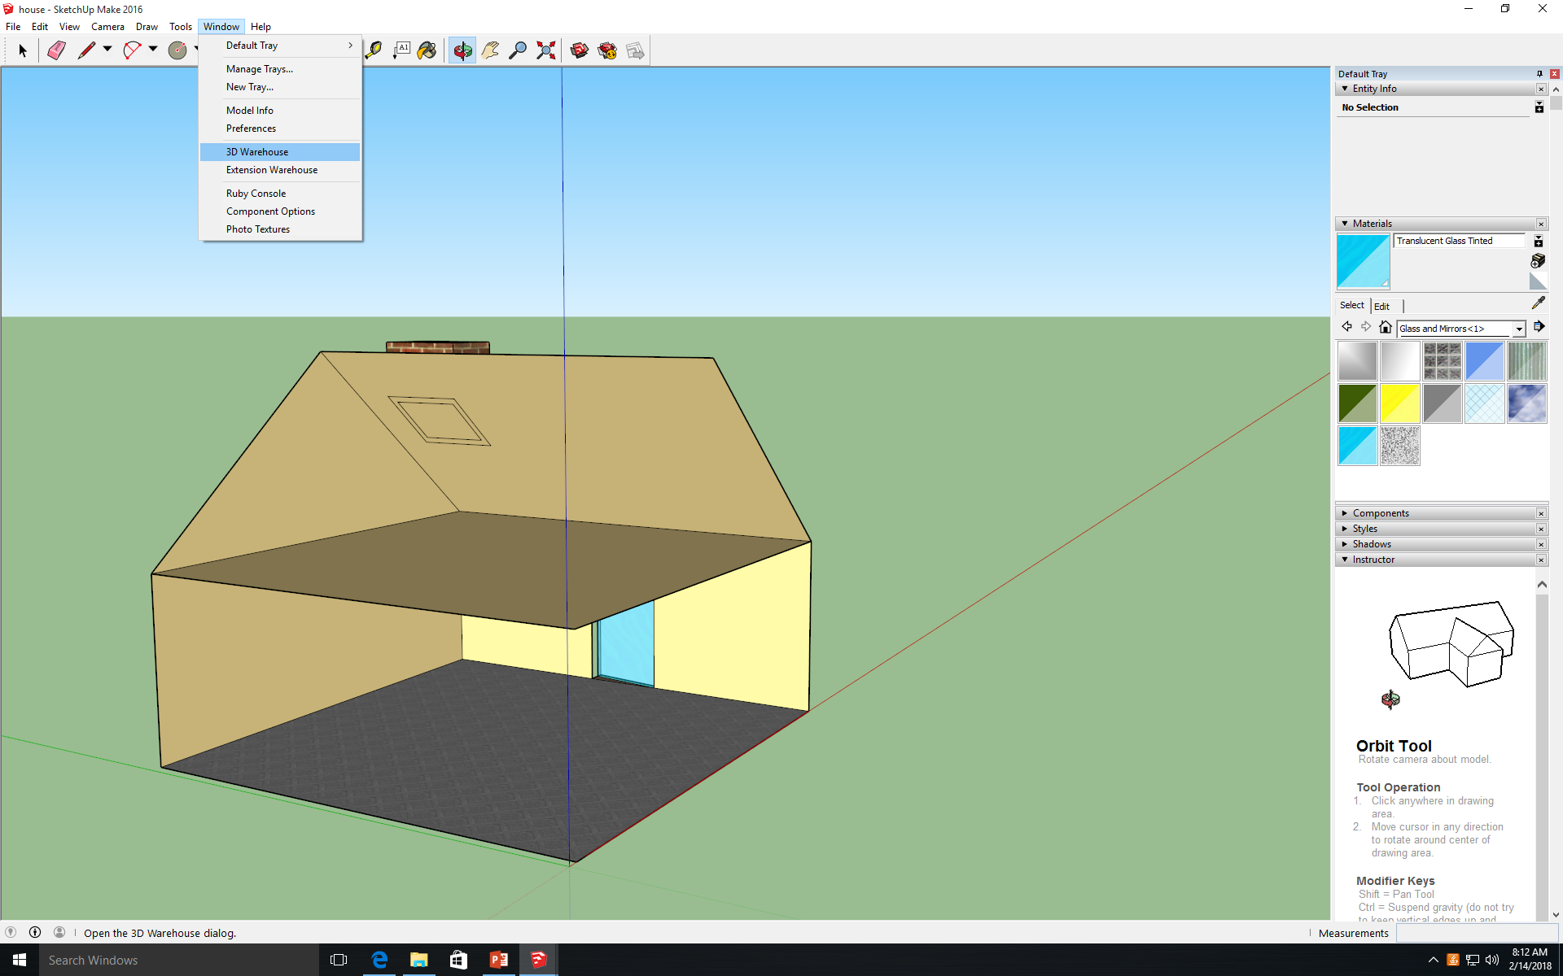
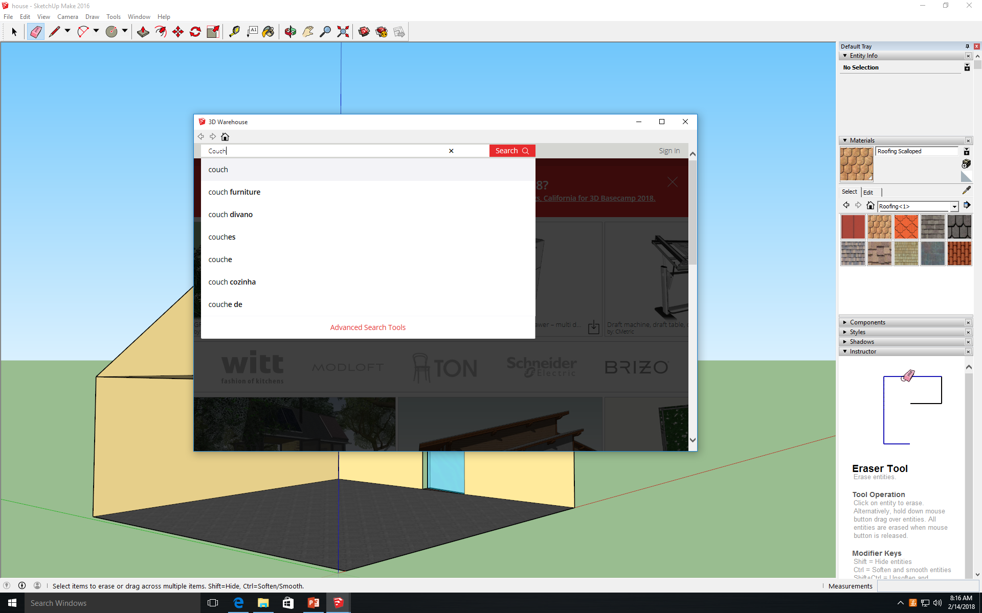
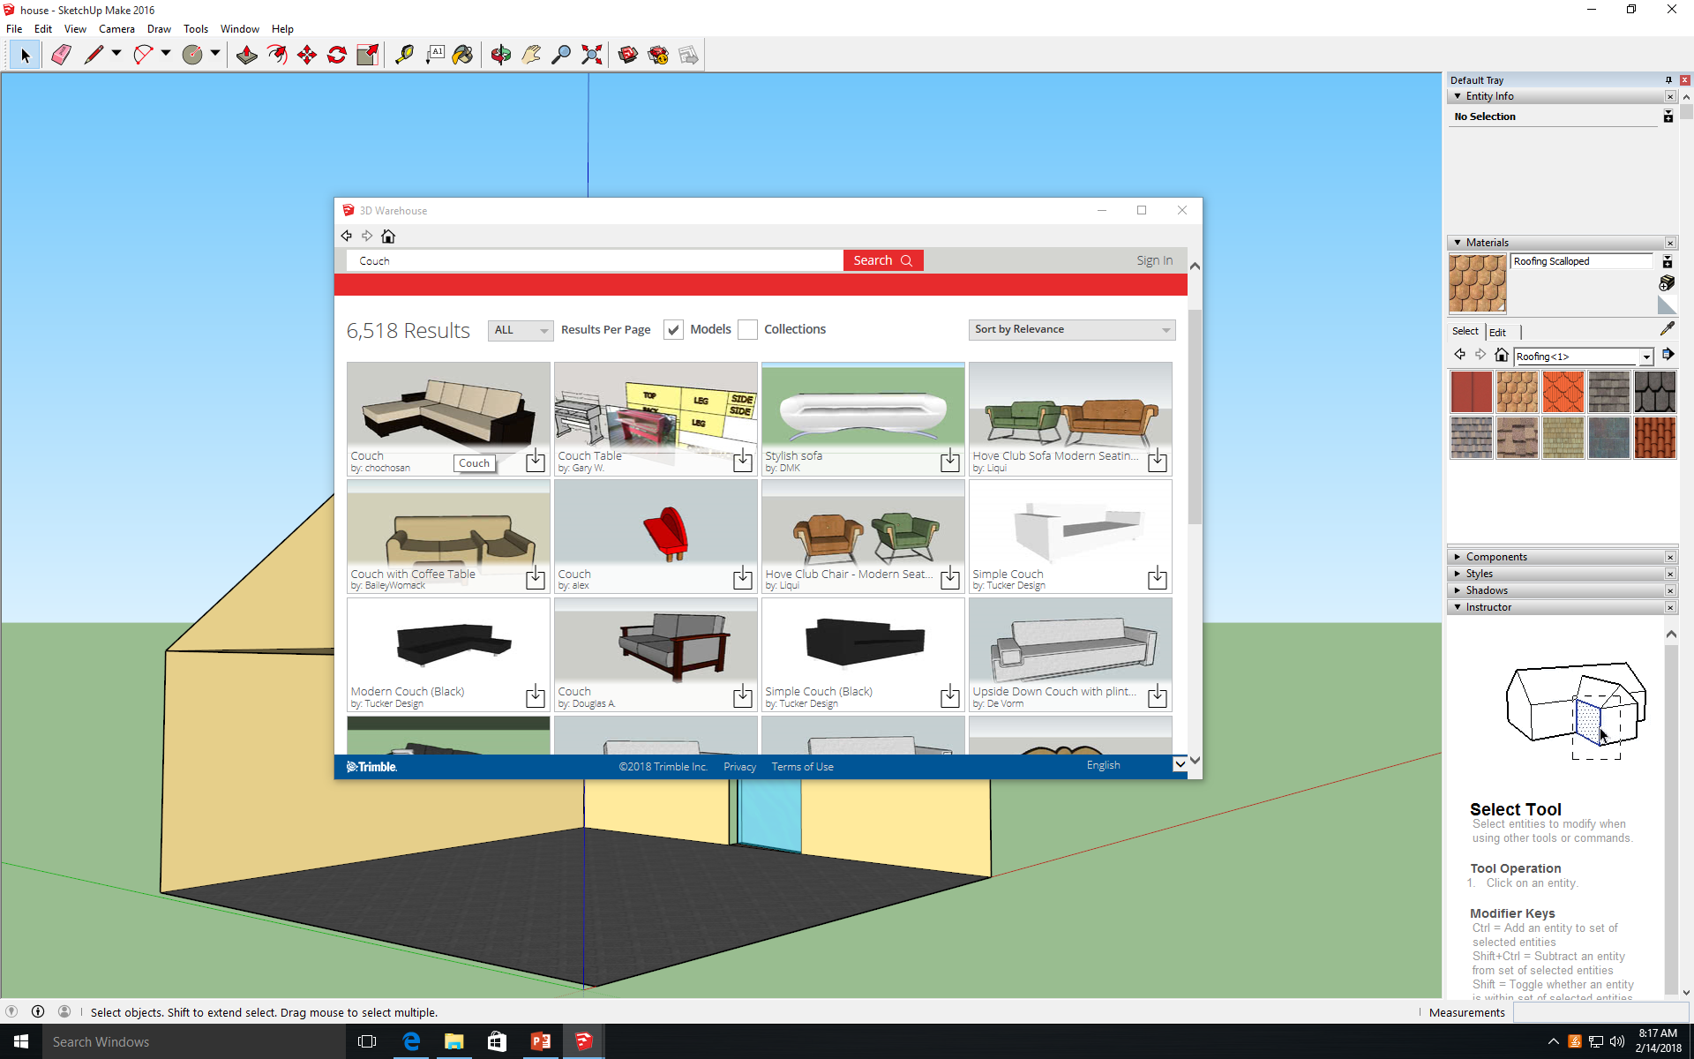
How to Add Furniture in a House Sketch Up
3. Go to Window and click on the tab that says “3D Warehouse”.
5. Select the item you want and click on it.
4. When the 3D Warehouse screen pops up, search the item you want.

Slide 4
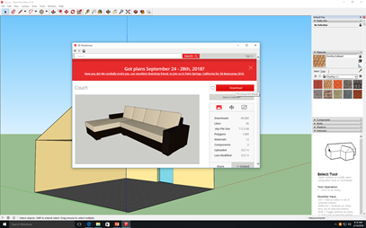
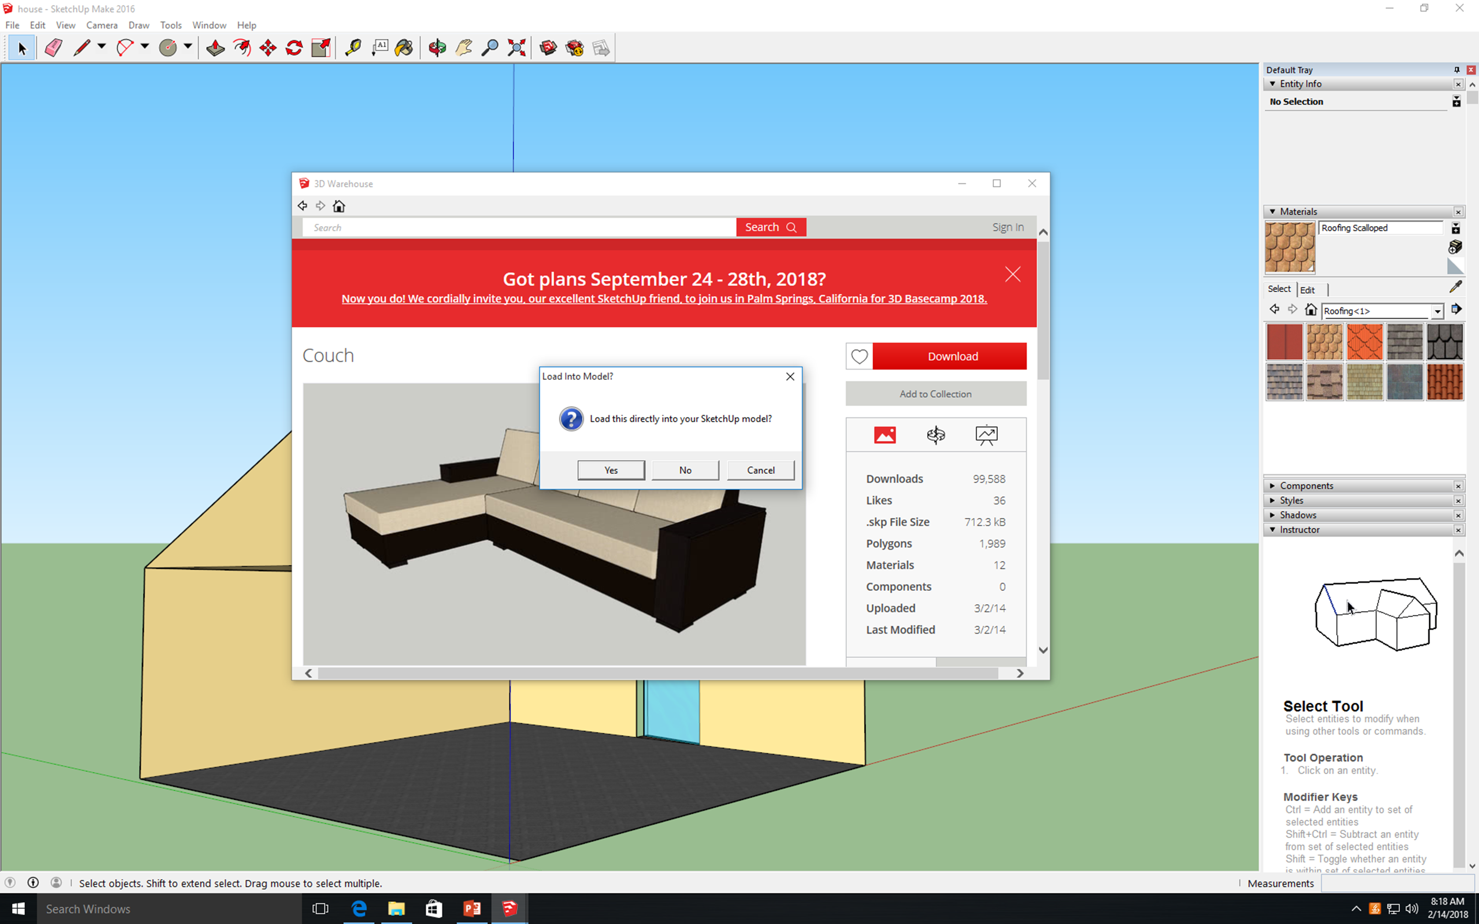
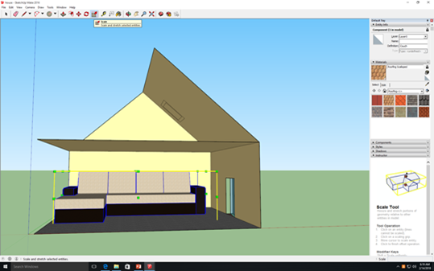
How to Add Furniture in a House Sketch Up
6. Once the chosen item comes up, click on the download button.
7. When the pop up comes up, click yes to import it directly to your house.
8. Place the item where you want and use the scale tool to minimize or maximize the item.

Slide 5
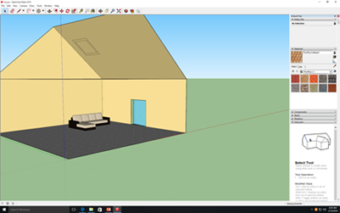
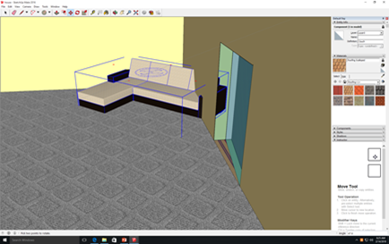
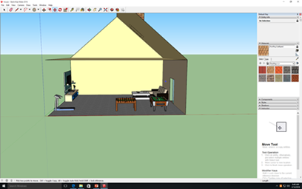
How to Add Furniture in a House Sketch Up
9. After you scaled your piece of furniture to your liking simply use the move tool to move it to a place of your liking.
10. Once you have moved your piece of furniture, Rotate the item by clicking the red plus signs on the top of the item.
11. Repeat steps 3-10 to decorate your house to your liking.

Slide 6
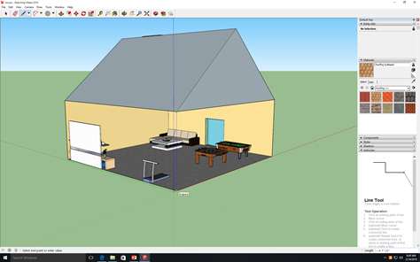
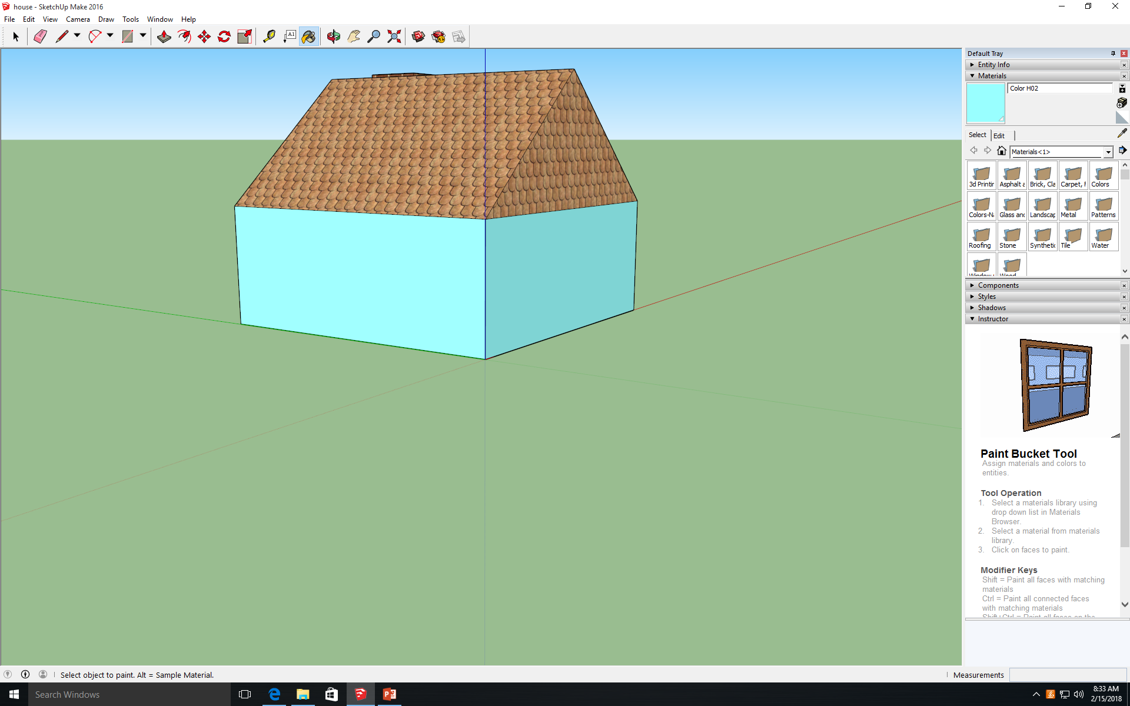
How to Add Furniture in a House Sketch Up
12. Now redraw the erased lines in step 2 in order to rebuild your house exteriors.
13. Now re-color and you are done.

